Slide 1
Digital marketing skills development planning template
Designed to be used alongside the modules
“Developing your team members with Smart Insights” and “Developing your marketing skills with Smart Insights”

Slide 2
How to use this template
This template has a section relating to each area of the GROW model, Goal, Reality, Options and Way forward.
Read the prompt questions then write a response in the workspace.
Use the ‘reality check’ questions to refine how the ideas will be translated into actions.
Use the responses to complete the blank plan summary sheet.
The plan summary sheet should be referred to during progress meetings and feedback sessions.

Slide 3






Goal: What do you want to achieve?
Questions for employee
Reality check
Where do you see yourself in one, five and 10 years?
Is the goal specific enough to be actionable?
What skills do you want to develop next?
Can progress be tracked easily?
What current tasks and projects do you enjoy the most?
Is the goal attainable and within reach?
What future opportunities and projects excite you?
Does the goal make sense for where the team member is and where they want to be?
What kinds of work experiences do you want to have?
Is the time frame realistic?
What do you hope to create or what kind of impact do you want to make?
What goals would you set set if you were in their position?

Slide 4
My development goal
Considering the questions on the previous slide, describe how you want to develop and then structure this goal in such a way that it is SMART that is, one that is Specific, Measurable, Attainable, Realistic, and Time-bound.
Example: I would like to be in a position to apply for a team leader role in the marketing team in two years.
My goal is…

Slide 5
Reality: What is the current situation?
Questions for employee
Reality check
How successful are you in your current role?
What skills, knowledge, or experiences does the employee need to make their goals happen?
What steps have you already taken to pursue your goals?
Do the steps they have already taken aligned to future directions?
What’s currently holding you back?
What requirements are missing? What are the gaps?
What knowledge, skills or experiences work in your favour?
How can the employee be a more competitive future candidate?
What are your current limitations or constraints?
Are there any other obstacles to attaining their goals?
What gaps in knowledge, skills or experiences are hindering your progress?
Are the employee’s current performance outcomes and competencies in line with their career ambitions?

Slide 6
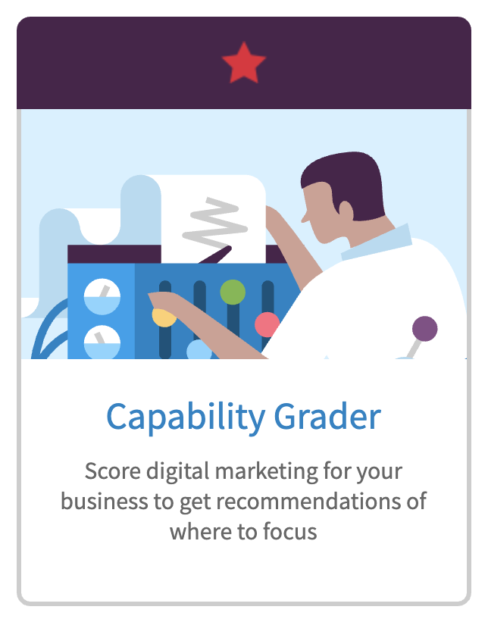
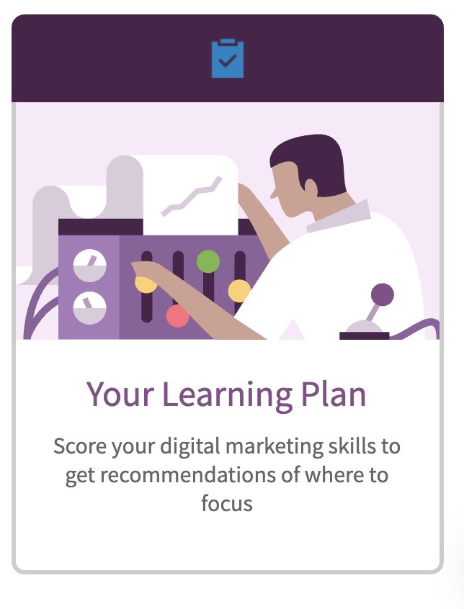
Smart Insights tools to determine current capability

Slide 7
Current situation
Considering the questions on the previous slide, reflect honestly on your current reality as it will be difficult to reach your development goal without fully considering your starting point.
Example: I am very successful in my current role and often take on extra responsibilities around administration and other general tasks. Often I hear people talking about other marketing channels, such as email and social media, and I want to be able to know how to use these to support a campaign.
My current reality…

Slide 8
Options: What choices do you have e.g. skills development, coaching?
Questions for employee
Reality check
What can you do right now to further develop the skills you need to reach your career goal?
What growth opportunities have you looked into or know about?
What assignments, projects, or experiences could you pursue?
What special projects could I assign you?
What are your networking or mentorship options?
Who could I introduce the employee to?
What has worked for you already? How could you do more of that?
Are there any cross-functional training opportunities?
What do you think you need to do to get closer to your goal?
Are there any relevant job openings, promotional opportunities, or business needs in the pipeline?
What is the first step you can take to achieve your goal?
What other learning opportunities or resources could you refer the employee to?

Slide 9
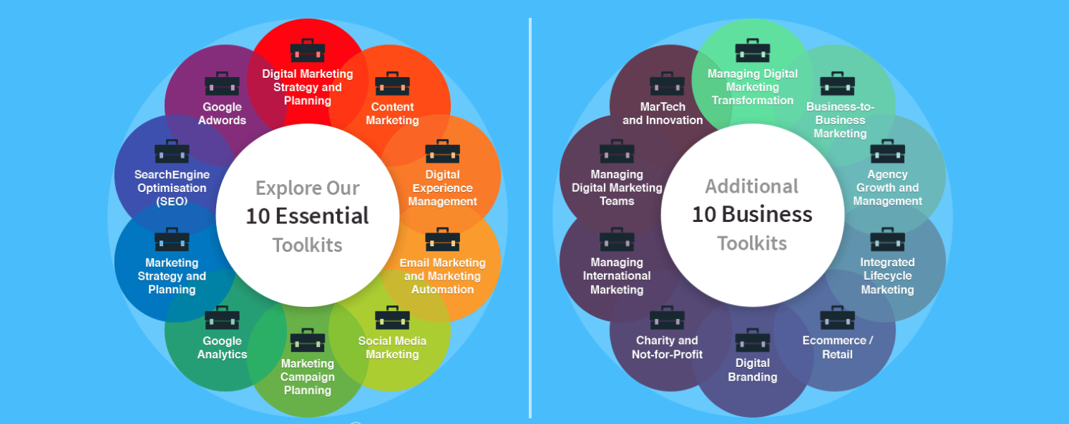
Select the most relevant Smart Insights toolkits

Slide 10
Options
Using the questions on the previous slide, consider all of the possible options for reaching your developmental goals including training platforms, skills development sessions as well as coaching and mentoring.
Example: I need to learn more about other aspects of marketing other than email. I have read some books and watched videos but it would be great to have some expert resource that links it all together. I get a lot from webinars and listening to podcasts as I can watch them when I have time.
My options…

Slide 11
Way forward: What action can you take?
Questions for employee
Reality check
What do you think you need to do right now?
Does the employee’s plan directly support their broader career goals?
How committed are you to achieving your goals?
Is the employee’s plan realistic and attainable?
What roadblocks are you expecting? How do you plan to deal with them?
What’s missing? Are there any steps you would add or change?
What resources will you need? What can the organization offer?
What resources do they need to be successful?
When are you going to start putting your plan into action?
How can I support them in achieving their goals?
What are three actions you can take this week?
Are the immediate actions reasonable?

Slide 12

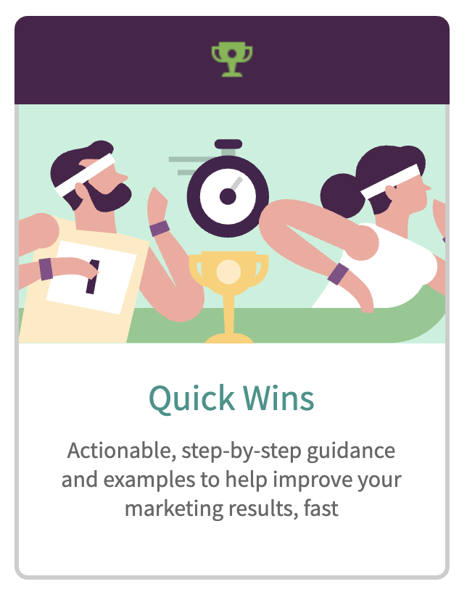

Choose resource formats that suit your learning preferences

Slide 13
Way forward
Using the questions on the previous slide, consider your commitment to development and establish a clear action plan for next steps.
Example: I will commit to completing one Learning Path per week and discuss how these skills can be implemented into my role. I will make time with the current team leaders to talk about how they manager their time. The organisation can support me by allowing me one hour per week to complete the learning in work time.
My way forward is…

Slide 14
Progress reviews and feedback sessions
How often do you need to report back on progress?
How will you report back any difficulties you might be having?
Is your goal still achievable in the timeframe?
What successes have you had?
What are you struggling with? What support do you need?
What systems or processes are impacting on the plan?

Slide 15
Progress reviews and feedback sessions
These meetings are essential to understanding what’s going on for you and how that might be impacting on goal achievement. Use the questions on the previous slide to help determine the best schedule for you.
Example: Progress review meetings will occur every three weeks. Feedback will be provided by my manager on a regular, unscheduled basis. I will be ready to discuss my successes and difficulties when asked.
My progress and feedback schedule:

Slide 16
Individual Development Plan: Jo Sample
Plan start date: 11/04/2020
Plan finish date: 25/06/2020
My goal is to increase my knowledge and skills across all digital marketing channels so I am in a good position to apply for a promotional position in two years.
Business goal match:
As the business grows there will be opportunities for team expansion which will require new team leads. Jo’s goal is aligned to the overall business direction.
My current reality:
I am very successful in my current role and often take on extra responsibilities around administration and other general tasks. Often I hear people talking about other marketing channels, such as email and social media, and I want to be able to know how to use these to support a campaign.
Manager comments:
At Jo’s last performance appraisal she was rated highly and she indicated a desire to take on additional responsibilities. She has done this but in order to progress further she needs to understand how each channel works and how they are integrated into a unified campaign. I believe she has the capacity to gain these skill but it will require consistent, dedicated effort to achieve her goal.
My options:
Work through the Smart Insights Learning Paths
Attend webinars and listen to podcasts
Join professional groups on LinkedIn
Attend professional networking sessions and events
Professional reading
Manager comments:
I agree with Jo’s options. She will be able to monitor her progress through the Smart Insights Dashboard and I will be able to see progress as well, offering support where needed.
Progress summary: 15/05/2020
Working steadily through the Learning Paths
Campaign planning – 100%
RACE Practical Digital Strategy – 45%
Has attended 2 webinars
Progress summary: (DD/MM/YYY):
My way forward:
I will commit to completing one Learning Path per week and discuss how these skills can be implemented into my role.
I will make time with the current team leaders to talk about how they manager their time.
The organisation can support me by allowing me one hour per week to complete the learning in work time.
Manager comments:
These commitments will be monitored via the dashboard and during progress and feedback sessions. I am committed to allowing Jo one hour per week to fully focus on learning. She is encouraged to book a quiet room to do this away from distractions.
Progress summary: 15/05/2020
My work load has increased with the resignation of one of the team. I have renegotiated the timeline for completion with my manager to take this into account.
Progress summary: (DD/MM/YYY):
Progress reviews and feedback sessions:
Progress review meetings will occur every three weeks.
Feedback will be provided by my manager on a regular, unscheduled basis.
Final review comments: 26/06/2020
I have successfully completed 4 learning paths that are most relevant to my current role and to support her progression toward applying for a promotional position. It has been difficult for me to find time to implement what I have learned but this will form the basis of my next learning plan.

Slide 17
Individual Development Plan:
Plan start date: DD/MM/YYYY
Plan finish date: DD/MM/YYYY
My goal is to
Business goal match:
My current reality:
Manager comments:
My options:
Manager comments:
Progress summary: DD/05/2020
Progress summary: DD/MM/YYY
My way forward:
Manager comments:
Progress summary: DD/MM/YYY
Progress summary: DD/MM/YYY
Progress reviews and feedback sessions:
Final review comments: DD/MM/YYYY

